Slide 1

Challenge
Générateur de Fiches Clients
Notes:
Functionality:
Built a comprehensive municipality data analysis system
Generates detailed PDF reports with financial, project, and historical data
Handles both municipality and inter-municipality data
Fully automated data collection from multiple sources -> Scrape the internet

Slide 2
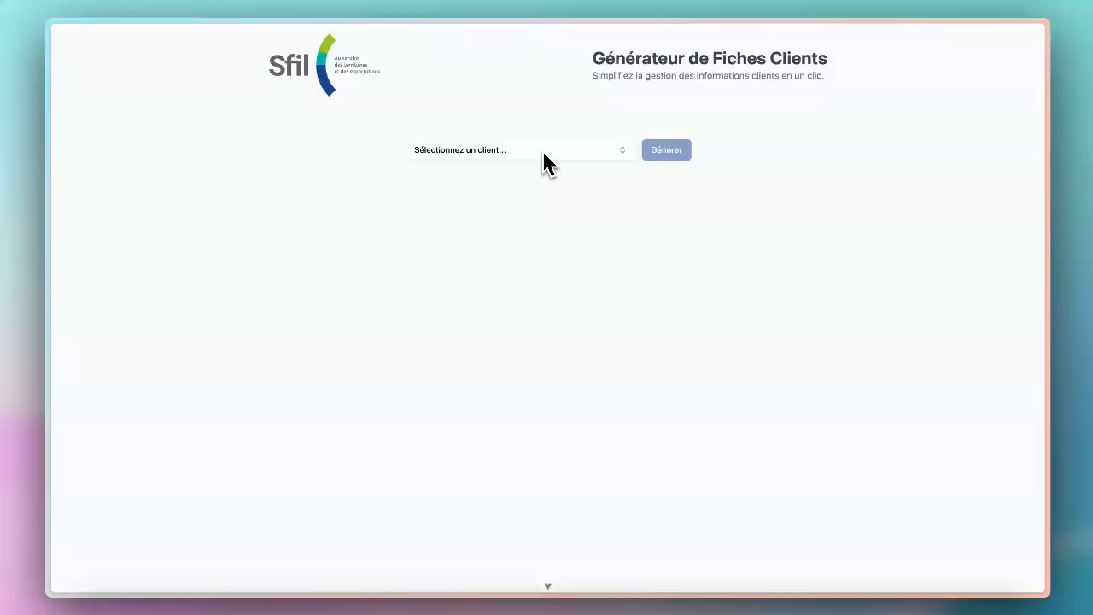

Slide 3

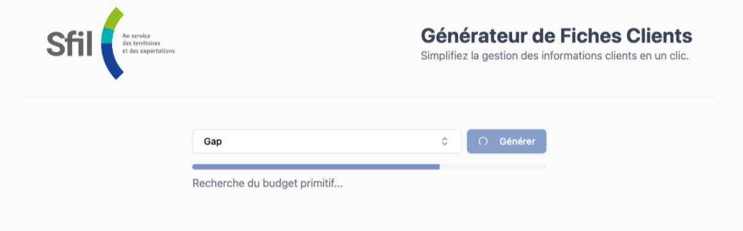
Tech - Frontend
Vue.js
Javascript Frontend Framework
Notes:
Modern Frontend:
Vue.js with Shadcn components
Responsive design
PDF generation capabilities

Slide 4





Tech – Agents
Orchestrator
Query
Query
…
GenAI Agent Swarm
Answer
Answer
Notes:
Backend is GenAI Agent Swarm
- Multiple Agents that each take care of one part of the project
Completely concurrent
Highly Modular but Specific & Parallelized Execution => <2min for generation of the whole file
AI Services Implementation
Advanced AI Agent System using Claude 3.5 Sonnet via Amazon Bedrock
Complex AI Workflow with specialized agents via Haystack:
ToolCallingAgent for data retrieval
RAG Pipeline for document search and context
Multiple specialized agents (contact, logo, budget, project)
Perplexity API integration for web search
Complex Generative AI Workflow:
Parallel processing of data sections
Multiple specialized AI agents
Tool-augmented responses

Slide 5


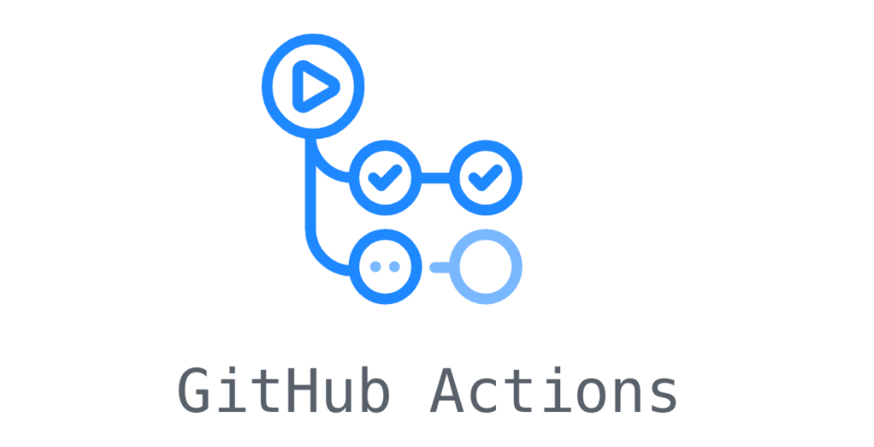


Tech – Deployment
“Serverless”
AWS Integration
CI/CD
Notes:
Serverless Architecture:
Lambda for backend (Python FastAPI)
Amplify for frontend (Vue.js)
ECR for Docker container registry
CI/CD Pipeline with GitHub Actions
Environment management with AWS Secrets
Architecture & Performance:
Containerized backend with multi-stage Docker builds
Efficient data processing:
Parallel execution
Caching mechanisms
Rate limiting
Security:
Environment isolation
API key management
CORS protection

Slide 6









Team
David
Deployment
Marco
Data
Jan
Frontend / Data
Alex
Agents
Luis
Agents

